Slide 1




Big Data Unites Sciences and Arts
Environmental
undertaken
activities

Slide 2


From the beginning of the project, different activities related to climate change and recycling have been carried out. Through them, students have learned that some actions in favour of the environment should be implemented to make possible to conserve natural resources, reduce pollution, and save energy

Slide 3
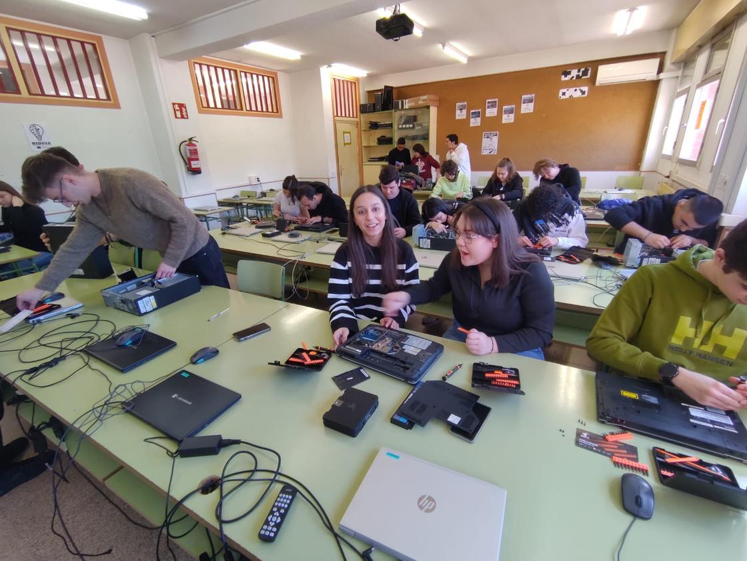
The repair programme of computing equipments developed since the beginning of the project has allowed the increase of the recycling of electronic devices and helped to break the current time lag of planned obsolescence.

Slide 4
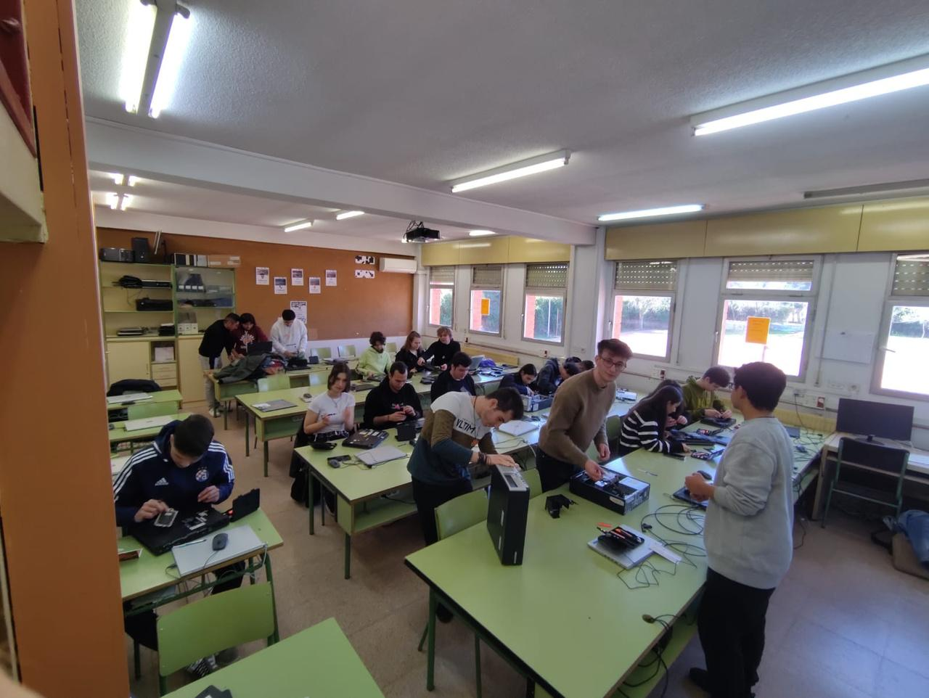
Thanks to the first recycling workshop held in Madrid, participants learned the basic repairing techniques that made easy to repeat the workshops as many times as necessary, avoiding damage to the environment and promoting the fight against climate change.

Slide 5
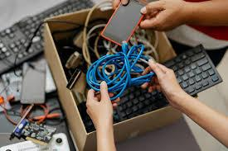
In the recycling workshops programme, the objectives were verified in each mobility, checking the number of equipment updated and repaired in the different recycling workshops.

Slide 6
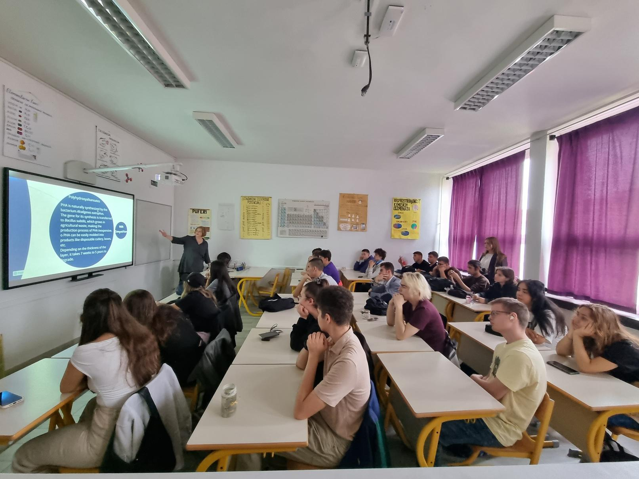
Apart from recycling computer equipments, in the diverse mobilities, were undertaken a series of workshops and courses coordinated by teachers and students from the host centers.

Slide 7
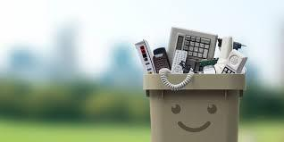
Participants have learned how to proceed to give a second life to many varied materials contributing to save natural resources and preserve the Earth for future generations.

Slide 8
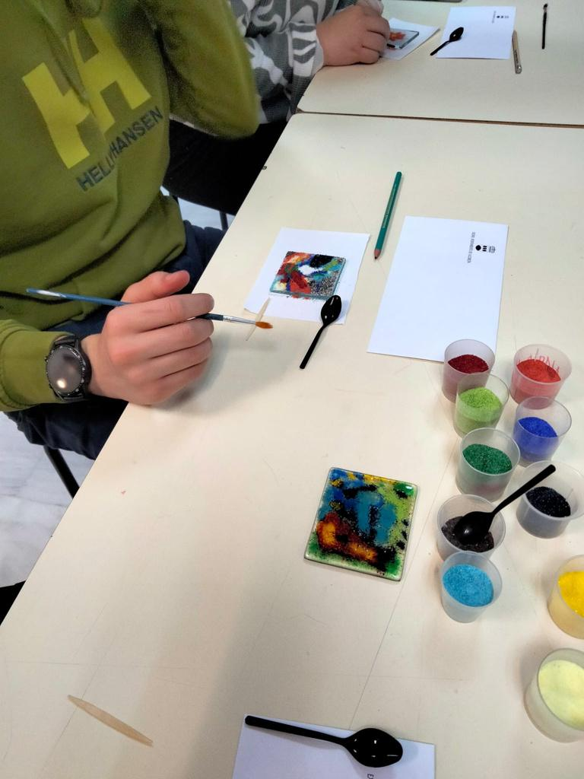
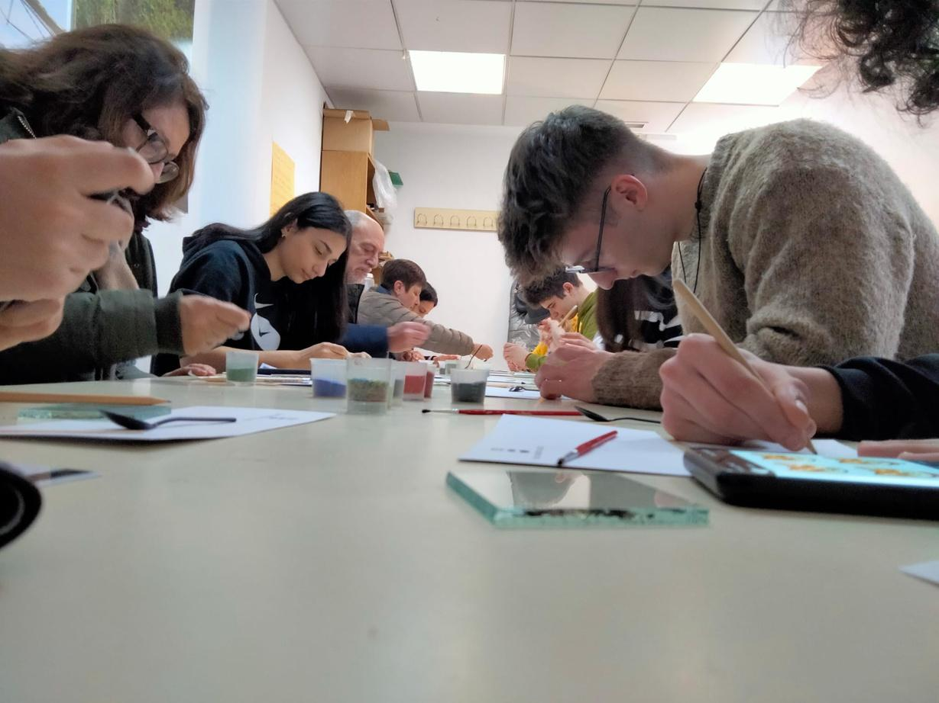
In the first Spanish mobility, a fritas workshop was conducted at the Alcorcón Glass Art Museum

Slide 9
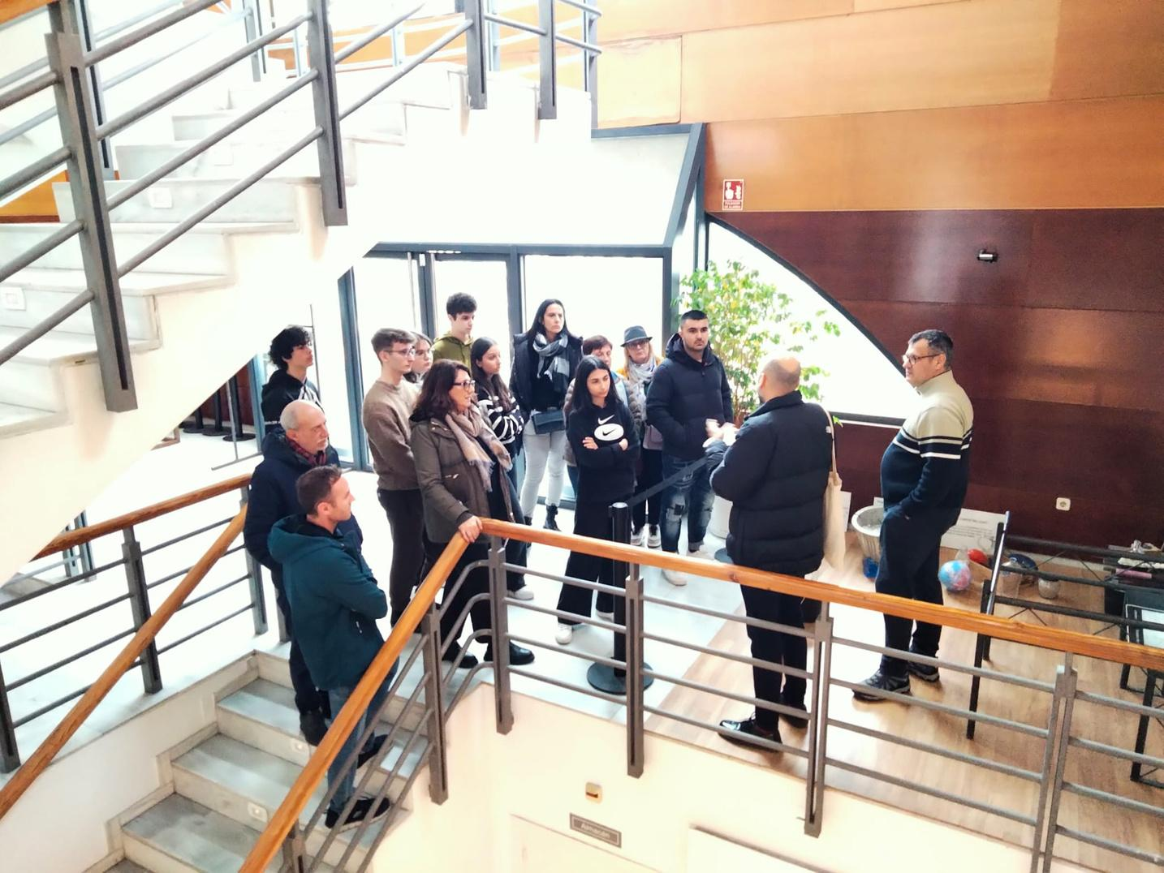
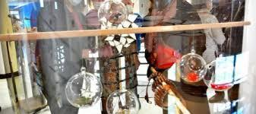
And participants took part in a glass casting session

Slide 10
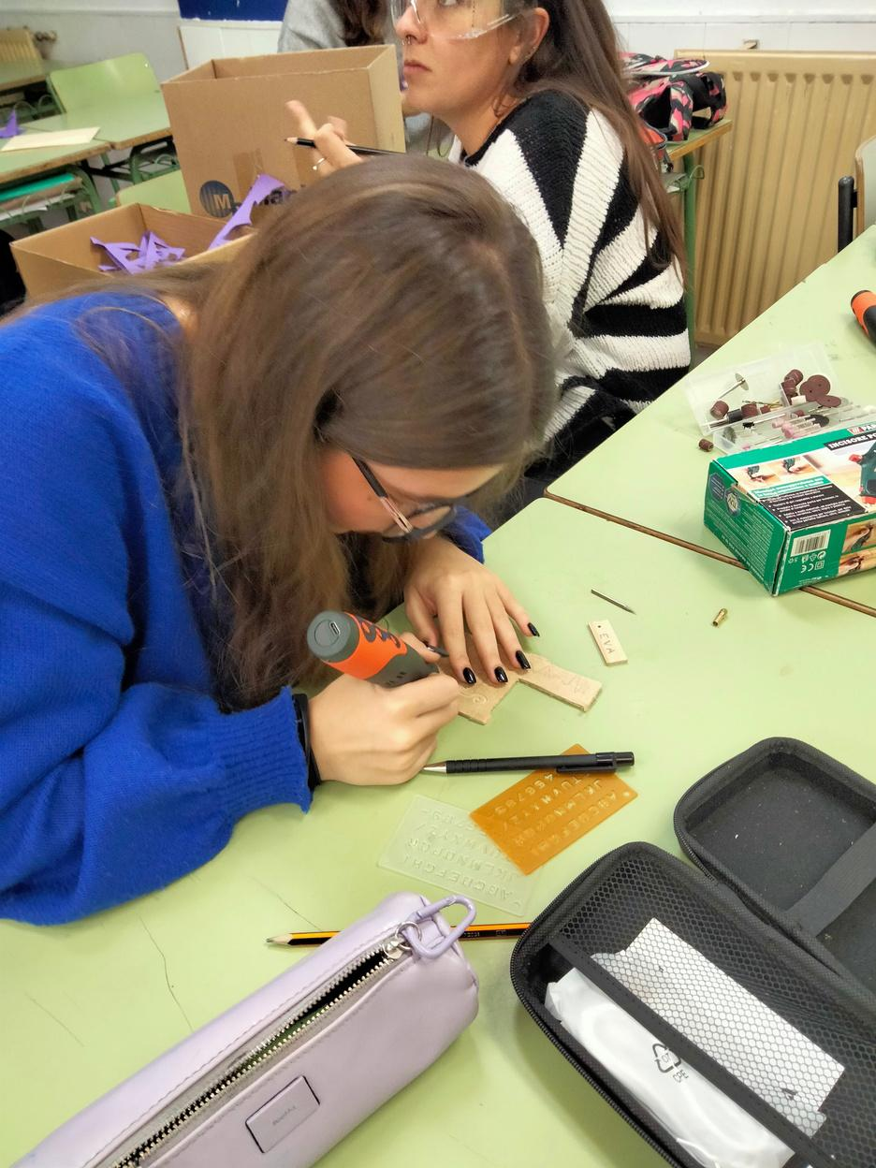
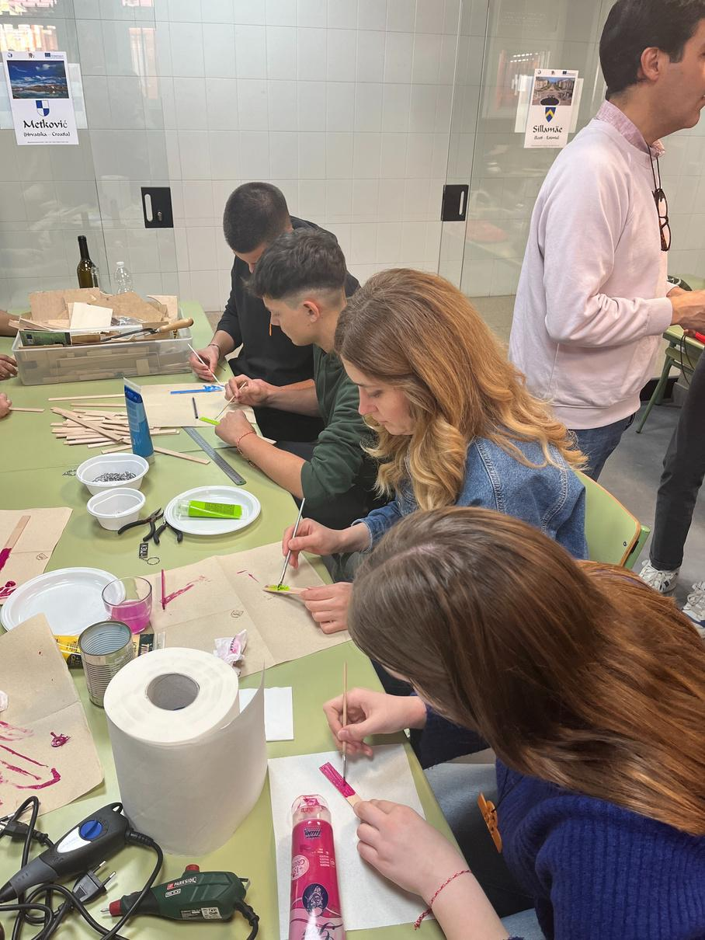
And several upcycling workshops were held in which participants could recycle e-waste into fruitful objects (jewelry, accessories and decorative objects)

Slide 11
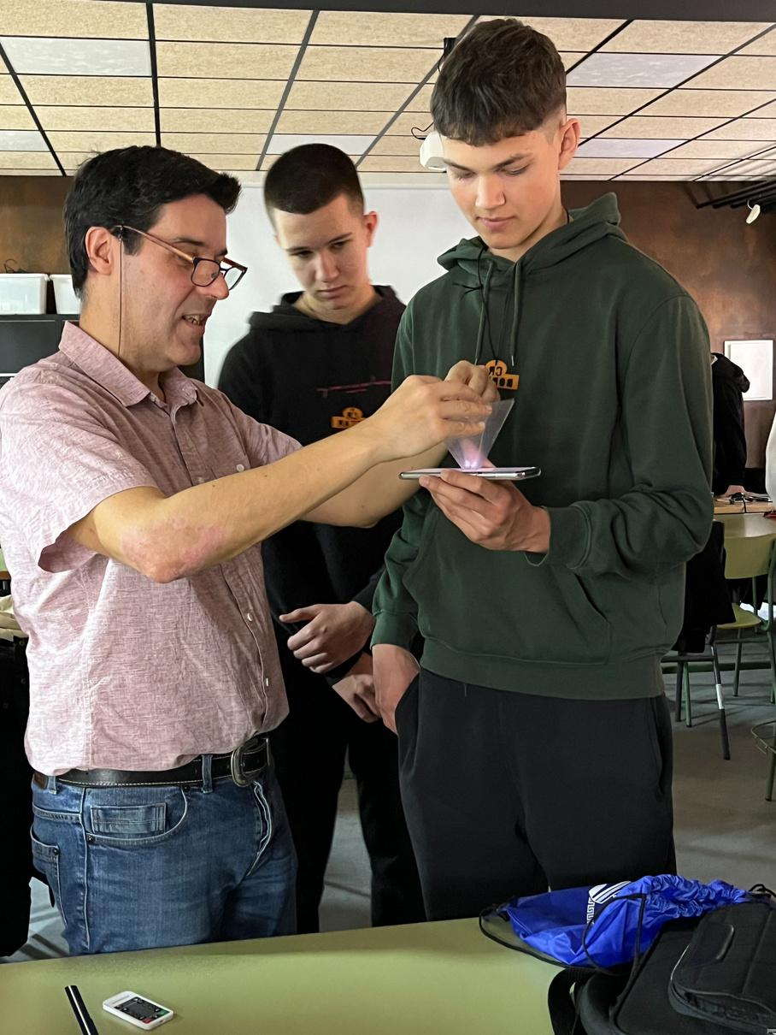
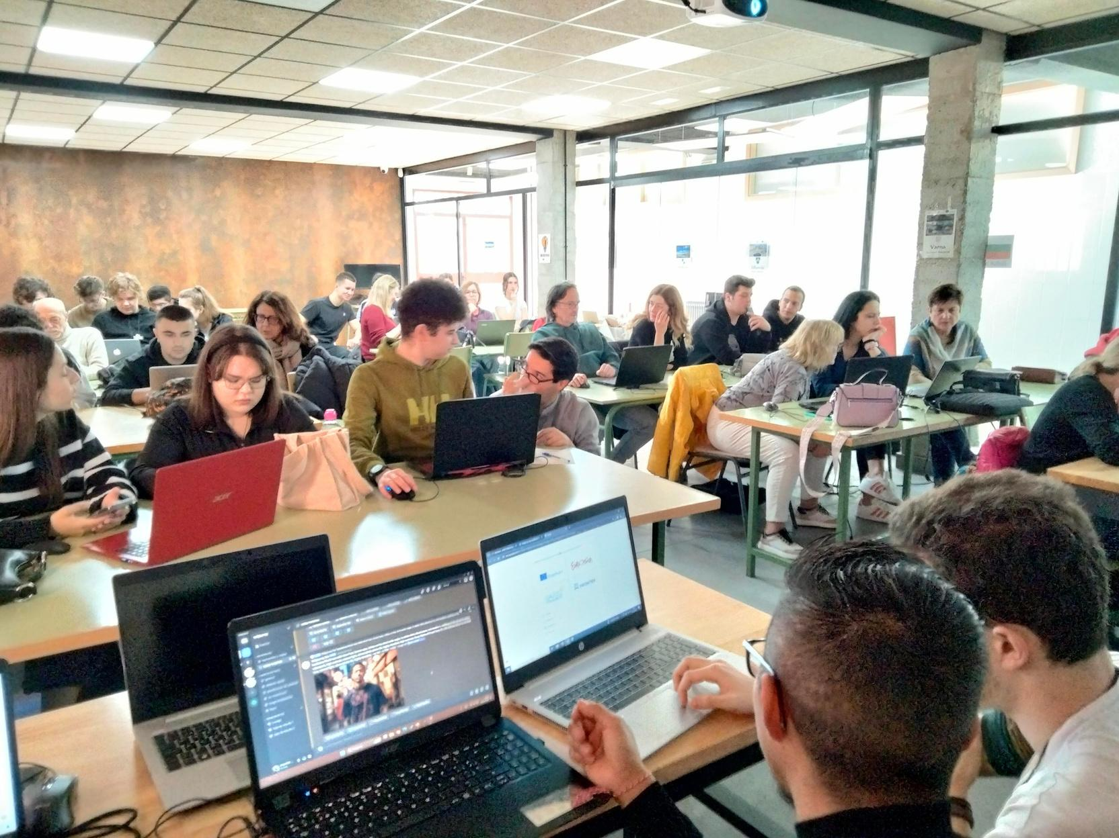
Moreover, was held a workshop to learn about the different types of plastics and analyze them and their effects in our everyday life

Slide 12
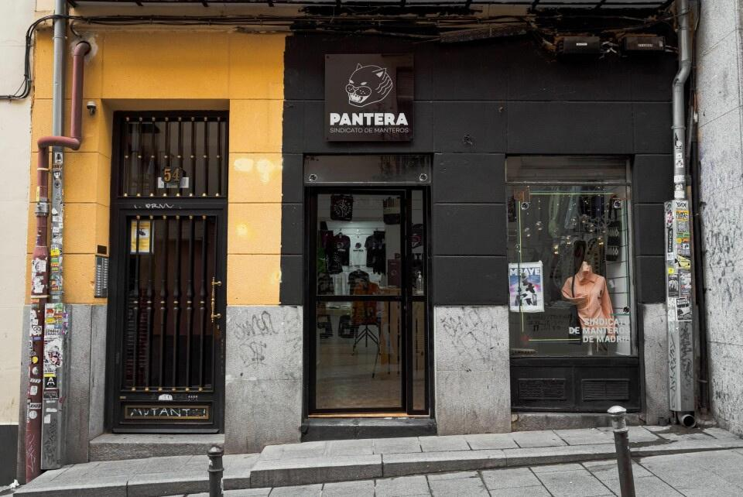
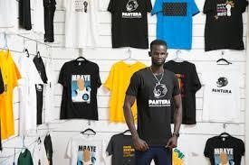
And, they paid a visit to the Pantera Shop, the Senegalese Street vendors center in Madrid

Slide 13
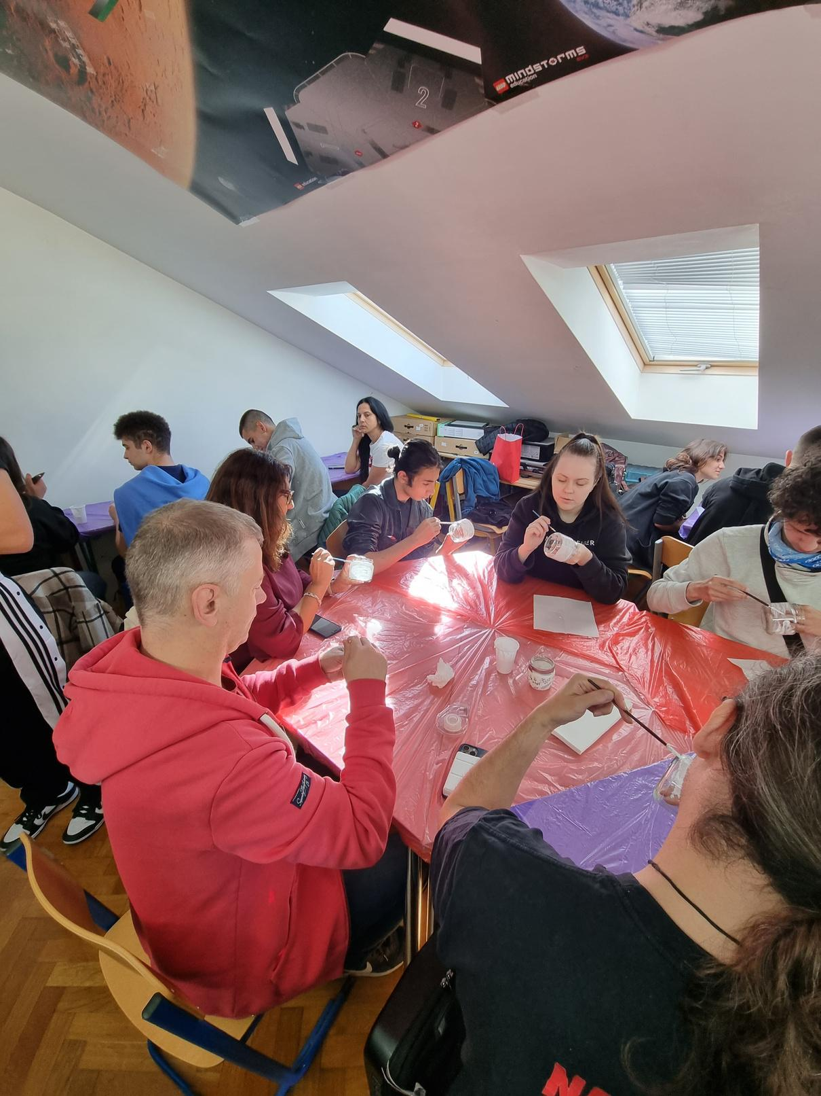
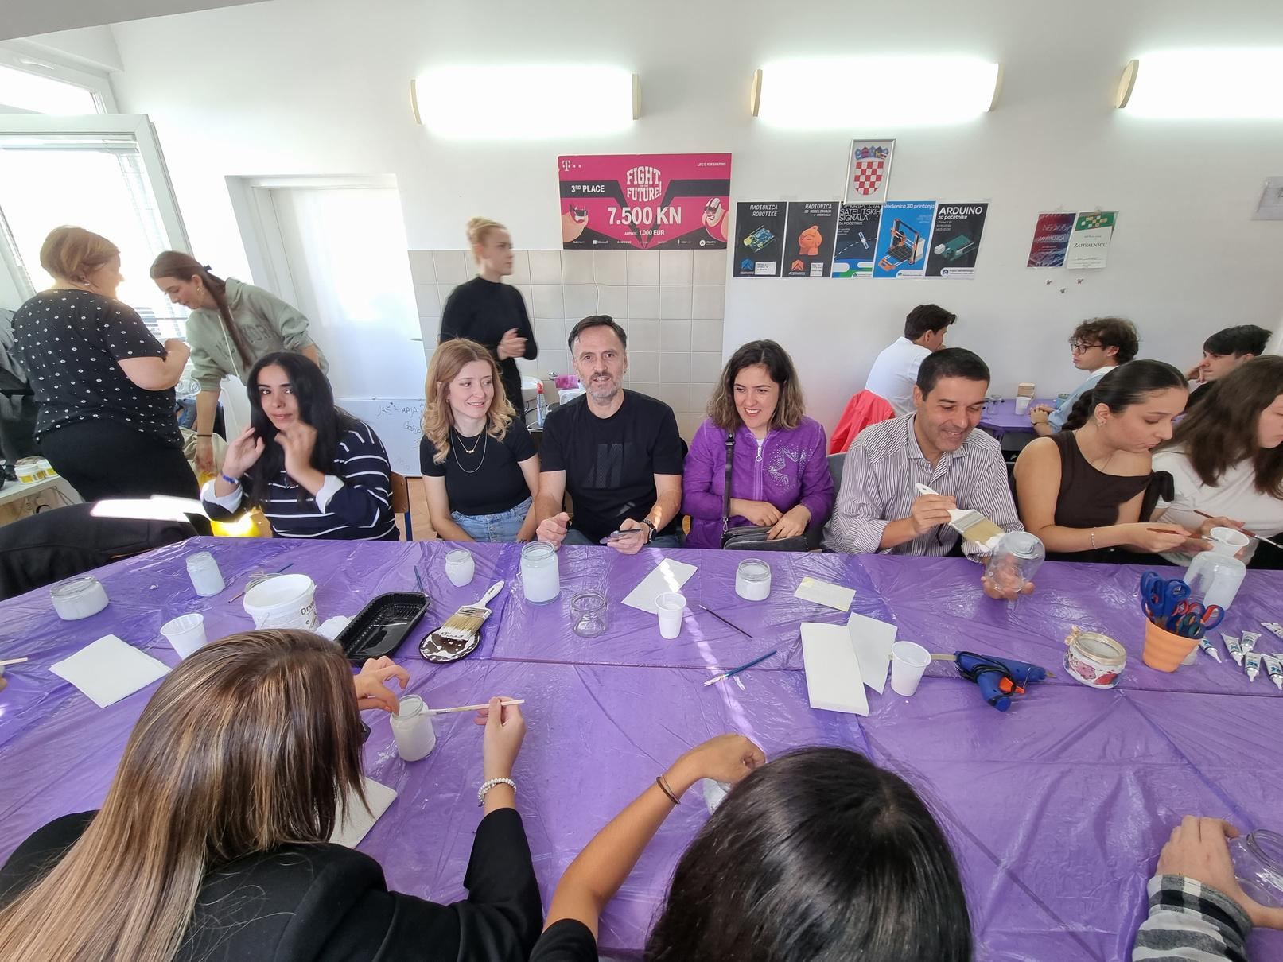
In Croatian mobility, a decoupage workshop was organized in order to learn how to give new life to diverse materials

Slide 14
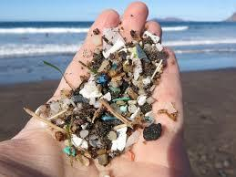
Participants took part in a workshop on microplastics and their recycling

Slide 15
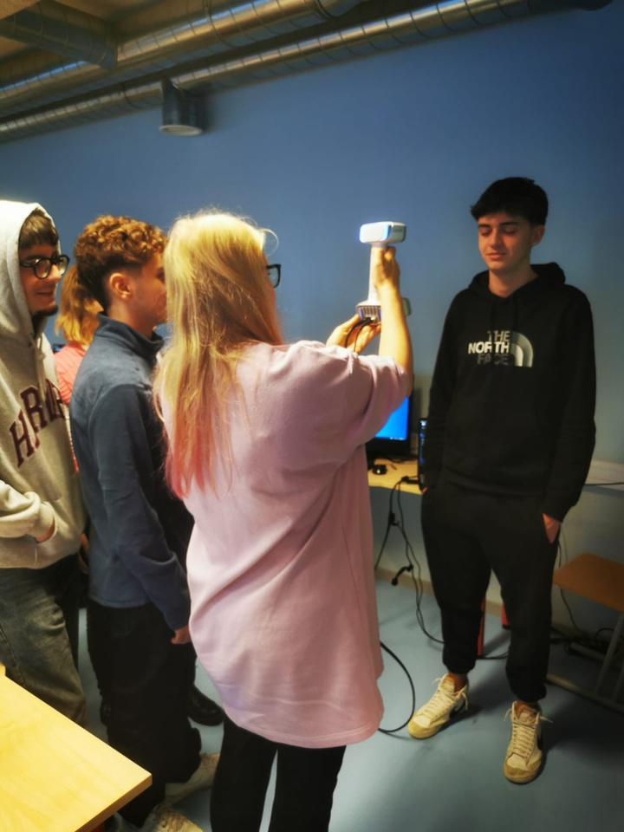
In addition, a 3D modelling workshop was conducted.

Slide 16
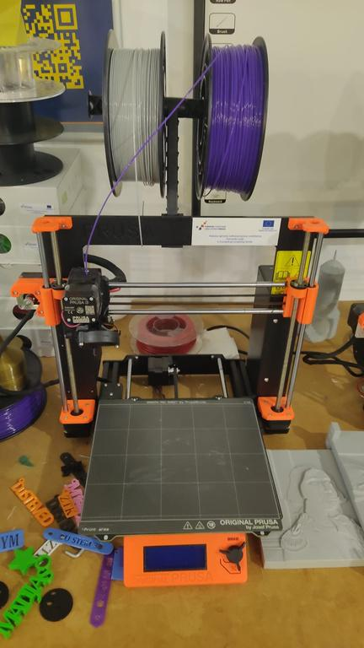
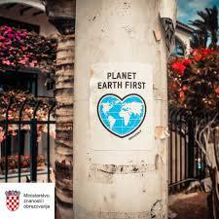
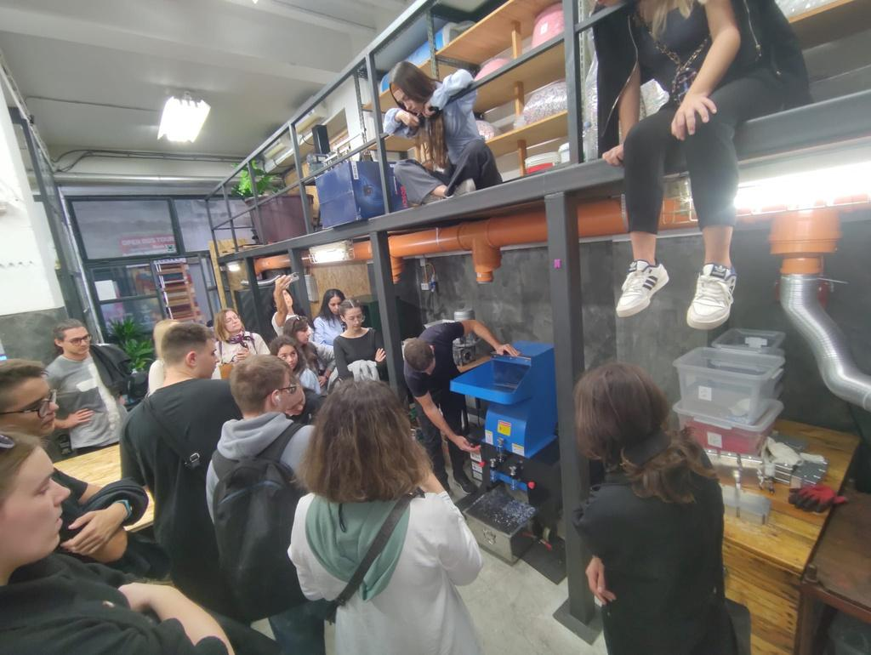
And finally, they paid a visit to the Croatian 3D printing association, to the Association for Creative Sustainable Development and Competitiveness (KORAK) and to Maritima Recycling Point in the Dubrovnik Seaport where they learned the process of recycling plastic in order to create new items

Slide 17
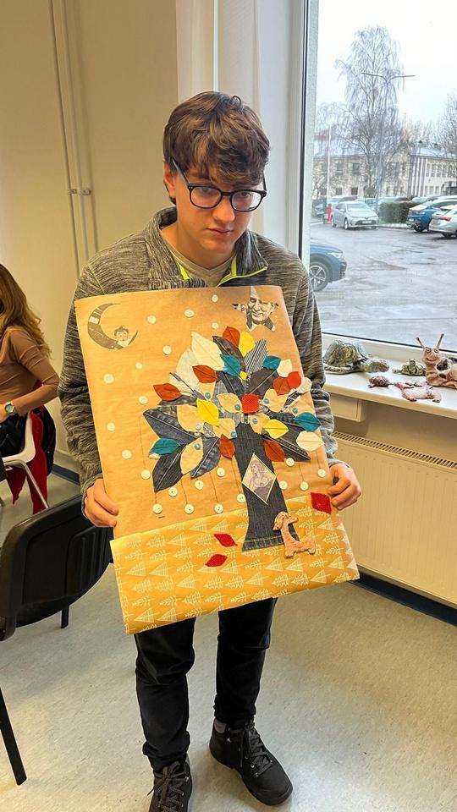
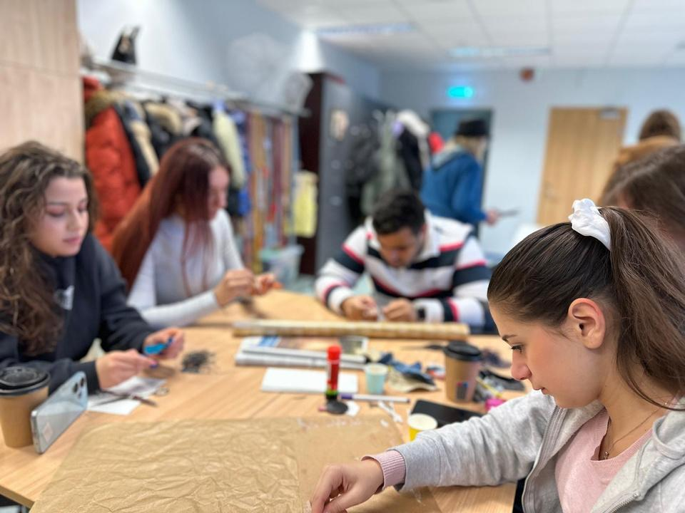
In Estonia, teachers and students took part in a collage upcycling workshop organized by the Art department of the Narva school.

Slide 18
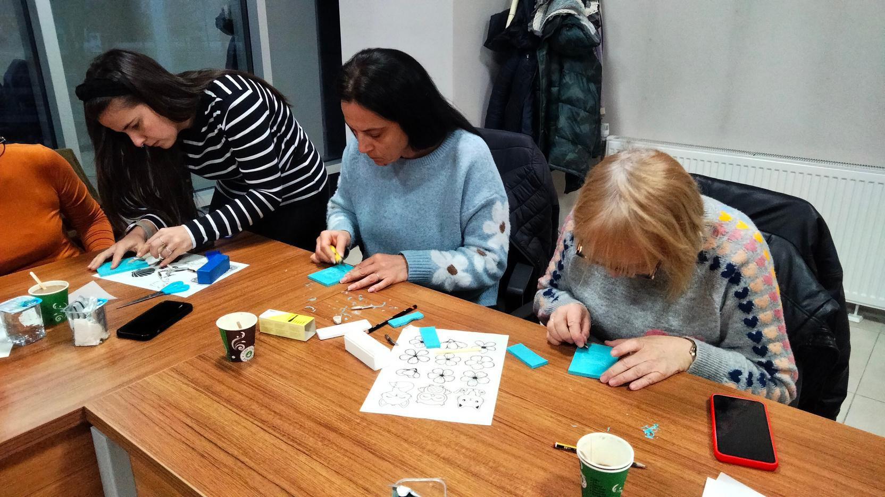
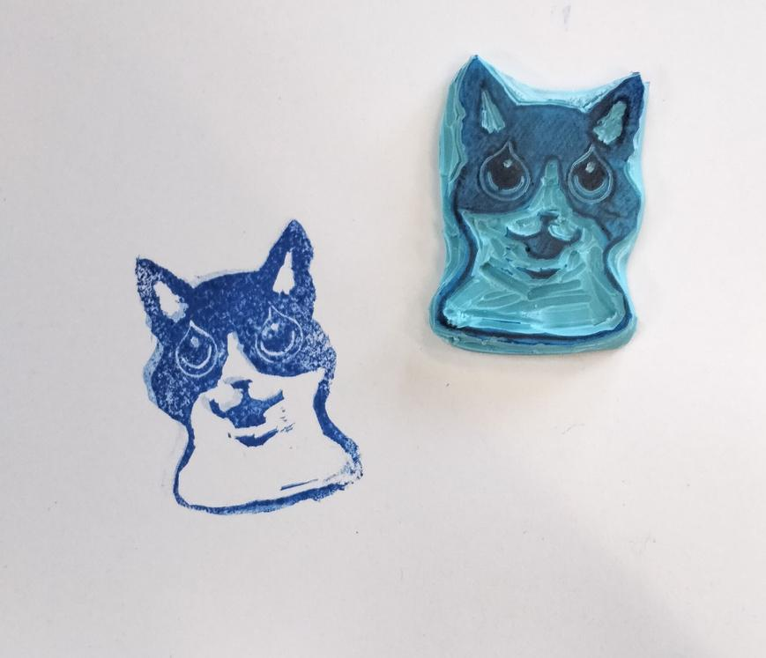
In Turkish mobility, several Art & crafts upcycling workshops were held: A carving stamps session in which participants could practice carving techniques with recycled materials and made their own personalized stamps

Slide 19
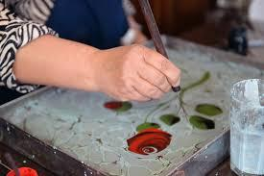
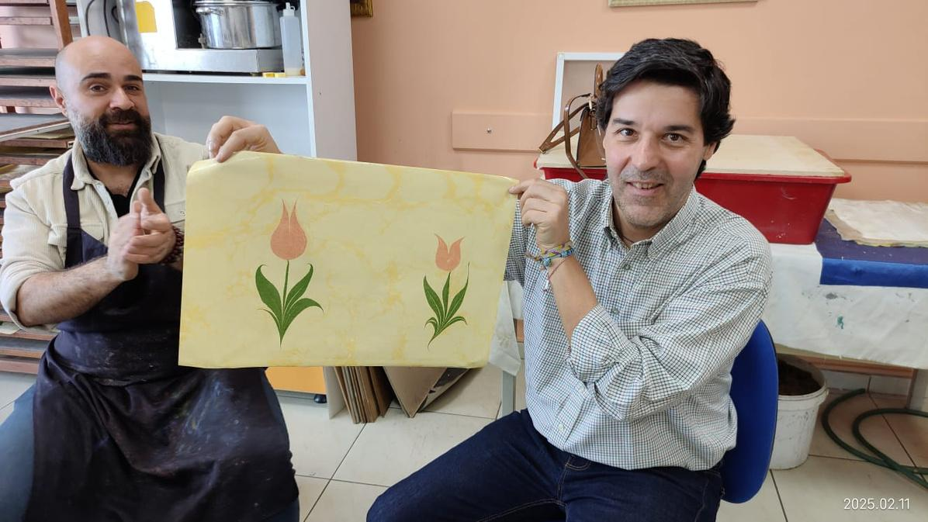
In the Düzce Youth Center, the paper artisans taught participants the basic paper marbling art methods

Slide 20
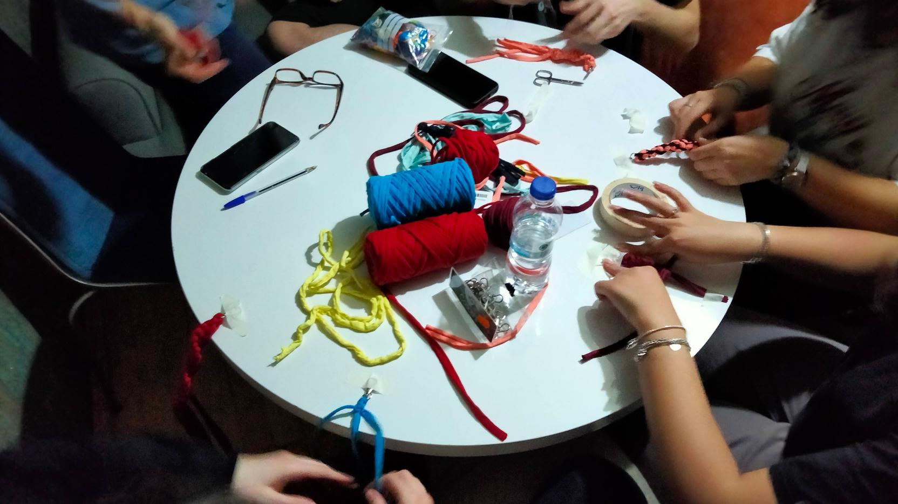
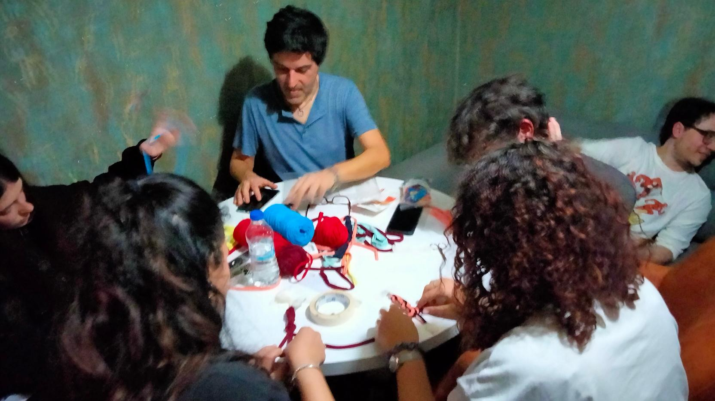
They also took part in a sustainable macramè workshop and learned the basic knots and practiced the main patterns with recycled fabric yarn

Slide 21
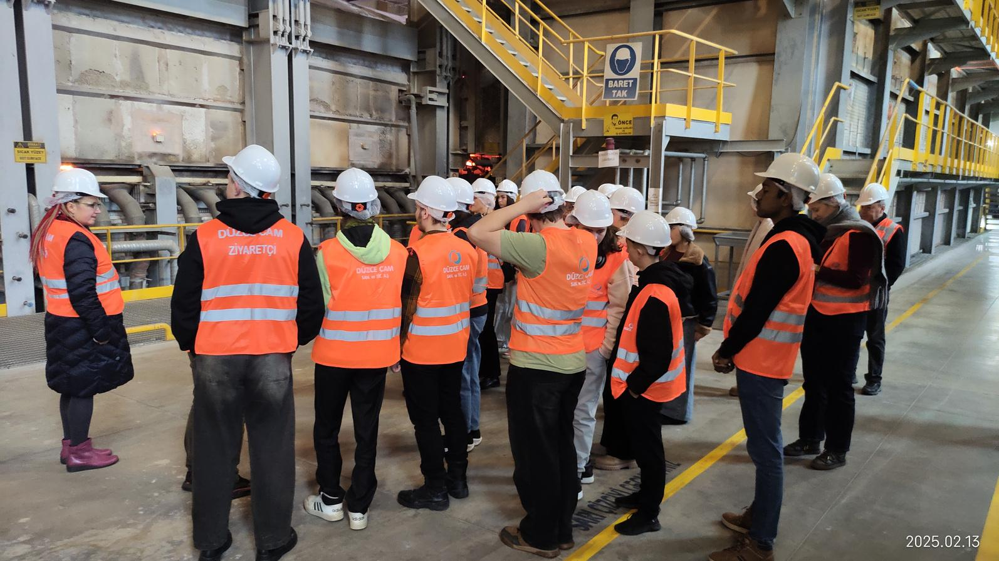
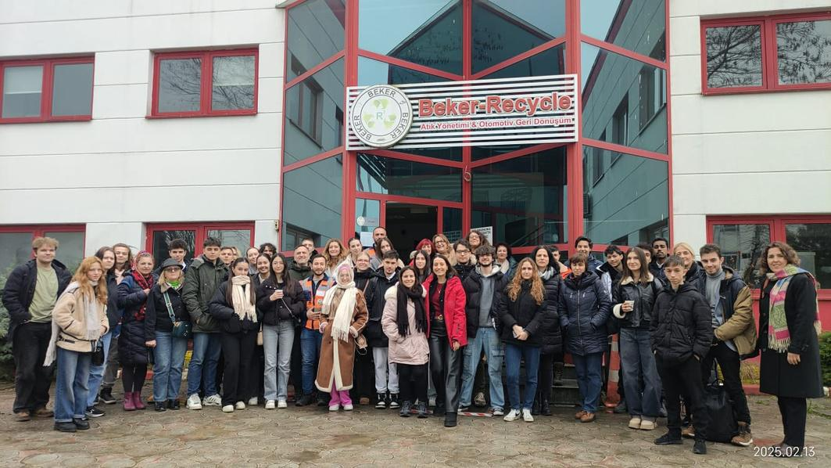
And they took a tour to Düzce industries related to recycling, visiting the facilities of Çınar Boru Profil, Doğtaş Kelebek Mobilya and Erciyas Steel Pipe

Slide 22
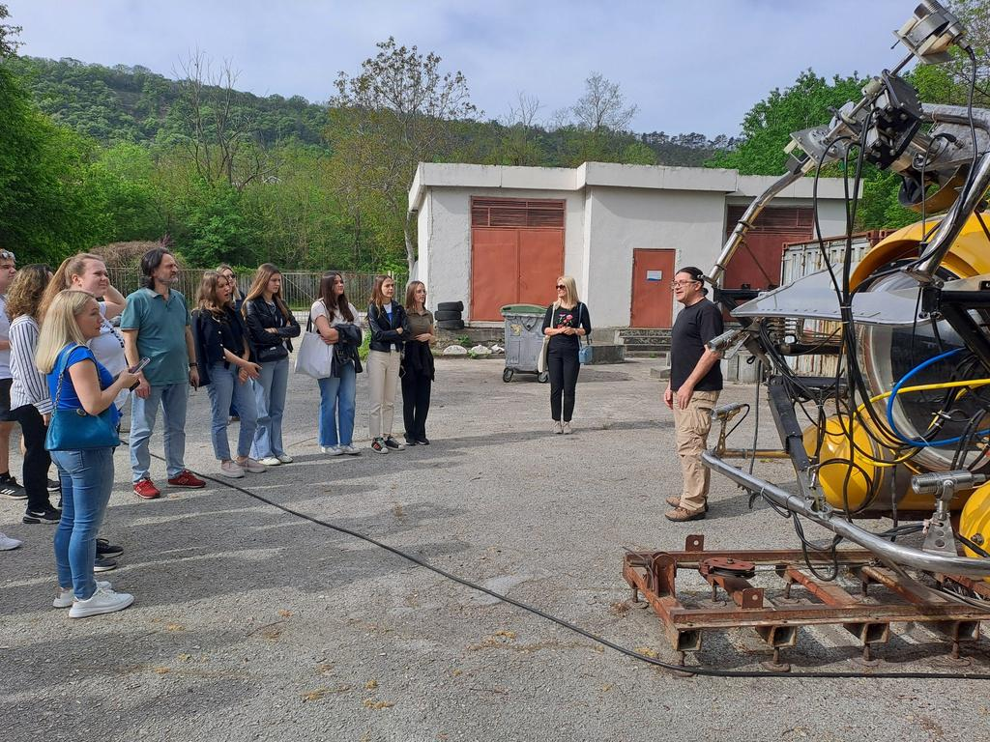
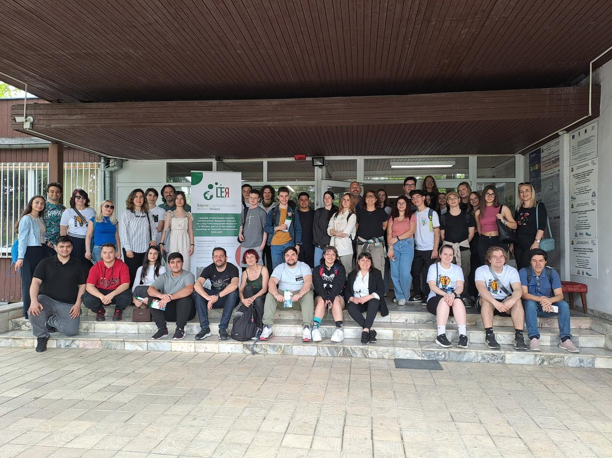
In the Bulgarian mobility, a working session on the problem of plastics in the Baltic Sea was held and participants visited the Institute of Oceanology

Slide 23
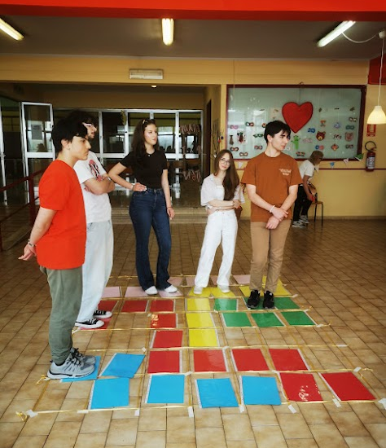
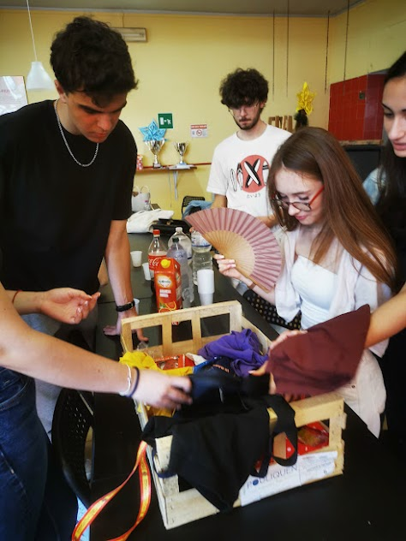
In Italia, participants took part in workshops on bartering, sustainable living, eco-friendly habits and circular economy that ended with a swap party.

Slide 24
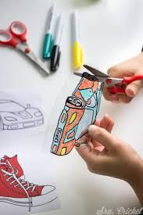
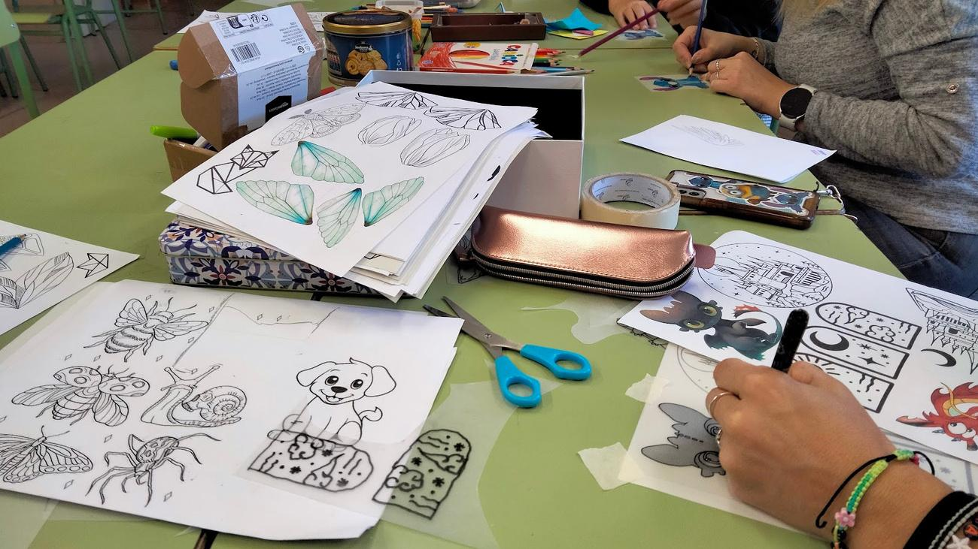
In the last Spanish mobility, participants engaged in a Magic Plastic workshop, learning how to make items by recycling different types of plastic

Slide 25
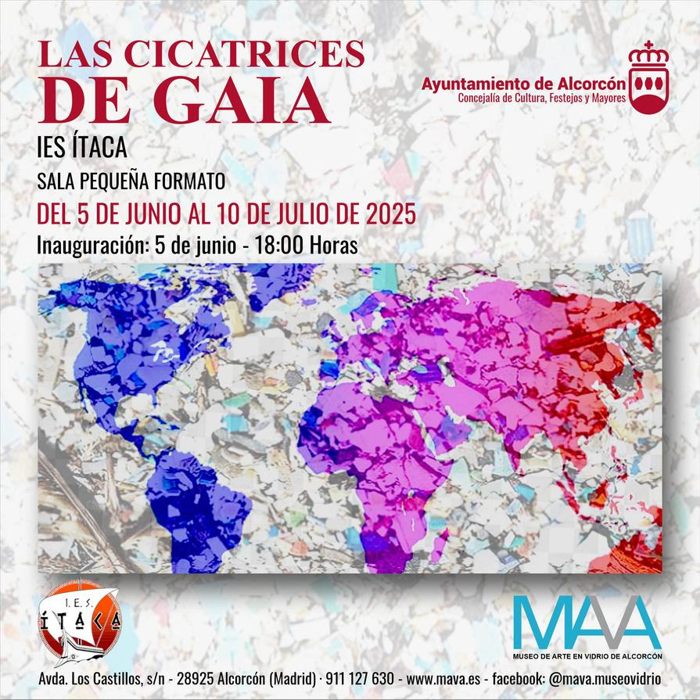
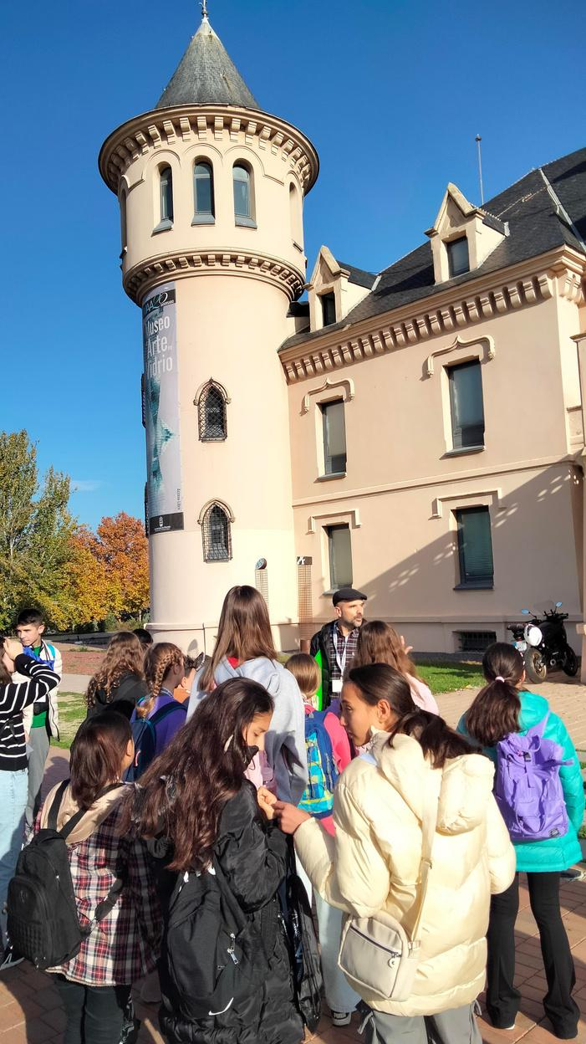
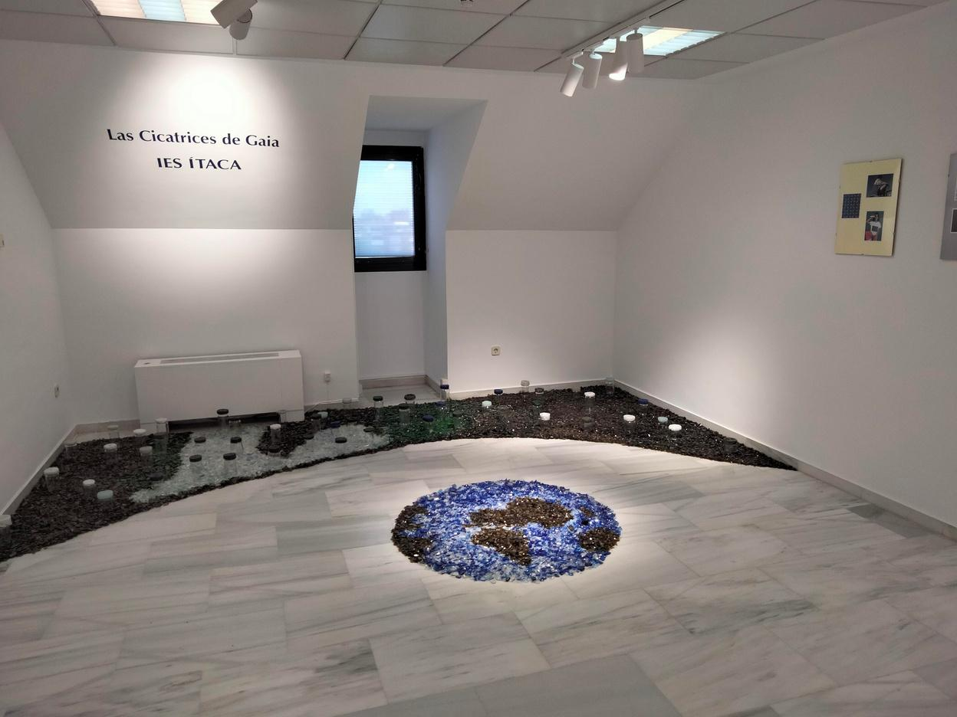
And they got a visit guided of the exhibition “the Scars of Gaia”, held in the Glass Art Museum of Alcorcón, by the Itaca’s Art baccalaureate students, curators of this Art exhibit focussed in the problems of the solid waste.

Slide 26
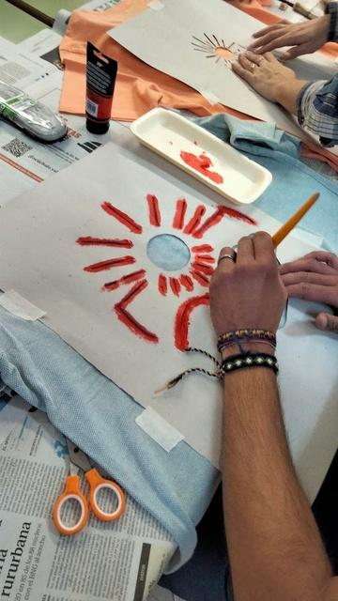
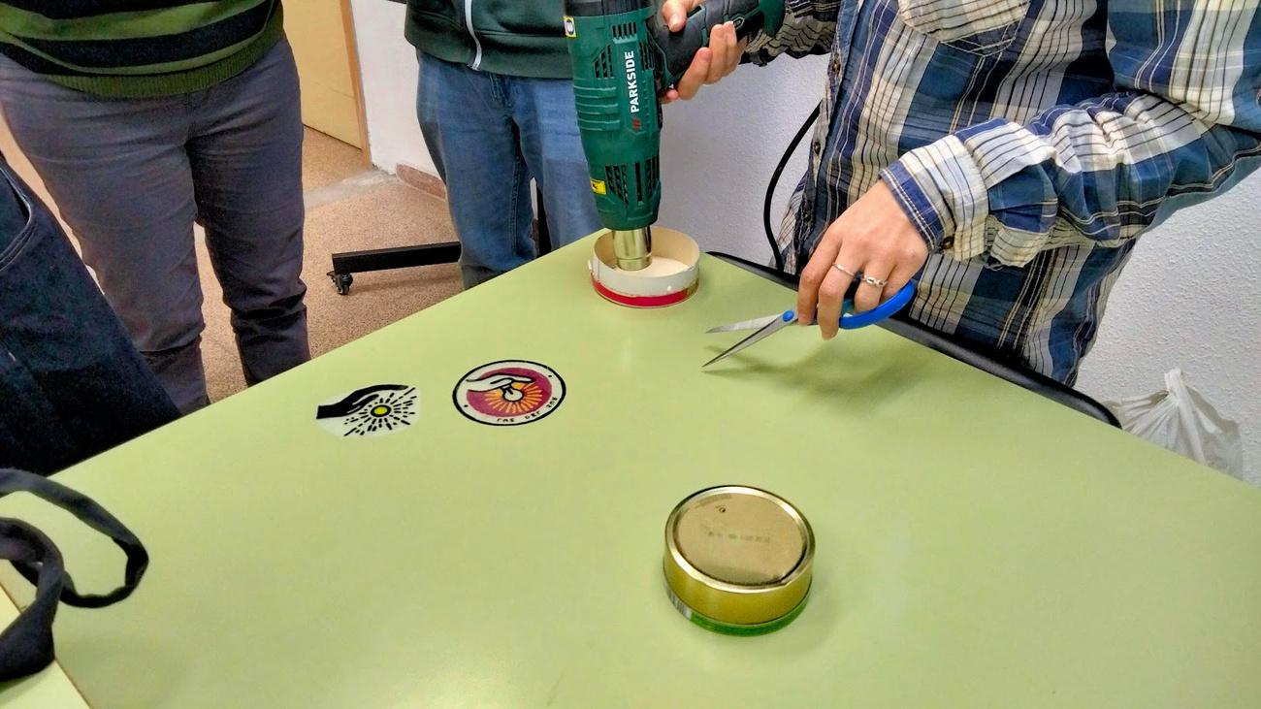
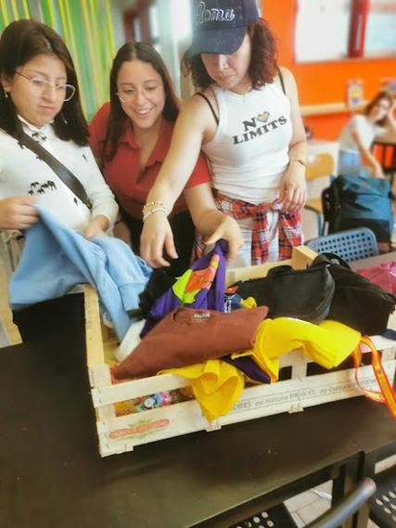
In parallel, in the different schools, some used clothing and books recycling workshops were held in which participants upcycled items donated by the students themselves. The customized clothes and the used books, along with the craft pieces made by teachers and students were sold in schools' solidarity markets, and the money raised were used in charitable causes.

Slide 27
